Slide 1
网络层的功能 与服务模型

Slide 2

Network layer
application
transport
network
data link
physical
transport segment from sending to receiving host
on sending side encapsulates segments into datagrams
on rcving side, delivers segments to transport layer
network layer protocols in every host, router
router examines header fields in all IP datagrams passing through it
network
data link
physical
network
data link
physical
network
data link
physical
network
data link
physical
network
data link
physical
network
data link
physical
network
data link
physical
network
data link
physical
network
data link
physical
application
transport
network
data link
physical
network
data link
physical
network
data link
physical

Slide 3
Network layer

Slide 4
Two Key Network-Layer Functions
forwarding: move packets from router’s input to appropriate router output
routing: determine route taken by packets from source to dest.
routing algorithms
analogy:
routing: process of planning trip from source to dest
forwarding: process of getting through single interchange

Slide 5
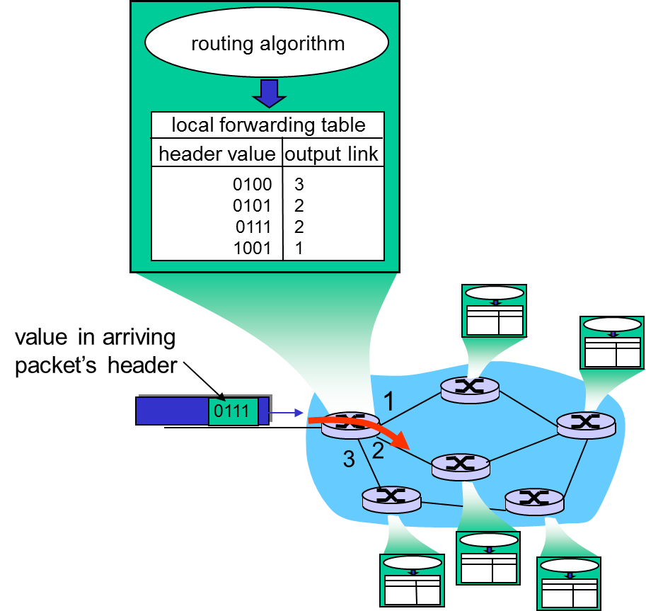
Interplay between routing and forwarding

Slide 6
Connection setup
3rd important function in some network architectures:
ATM, frame relay, X.25
before datagrams flow, two end hosts and intervening routers establish virtual connection
routers get involved
network vs transport layer connection service:
network: between two hosts (may also involve intervening routers in case of VCs)
transport: between two processes

Slide 7
Network service model
Q: What service model for “channel” transporting datagrams from sender to receiver?
Example services for a flow of datagrams:
in-order datagram delivery
guaranteed minimum bandwidth to flow
restrictions on changes in inter-packet spacing
Example services for individual datagrams:
guaranteed delivery
guaranteed delivery with less than 40 msec delay

Slide 8
Network layer service models:
Guarantees ?
Network
Architecture
Internet
ATM
ATM
ATM
ATM
Service
Model
best effort
CBR
VBR
ABR
UBR
Congestion
feedback
no (inferred
via loss)
no
congestion
no
congestion
yes
no
Bandwidth
none
constant
rate
guaranteed
rate
guaranteed
minimum
none
Loss
no
yes
yes
no
no
Order
no
yes
yes
yes
yes
Timing
no
yes
yes
no
no

Slide 9
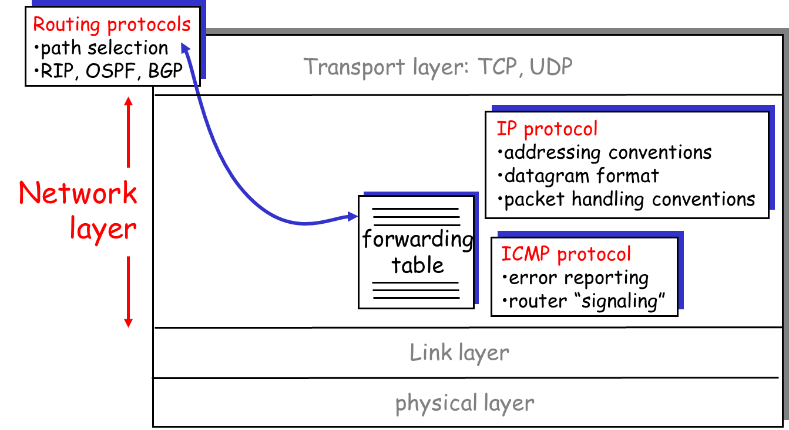
The Internet Network layer
Host, router network layer functions:

Slide 10

Summary
Two Key Network-Layer Functions
Network layer service models

